Slide 1
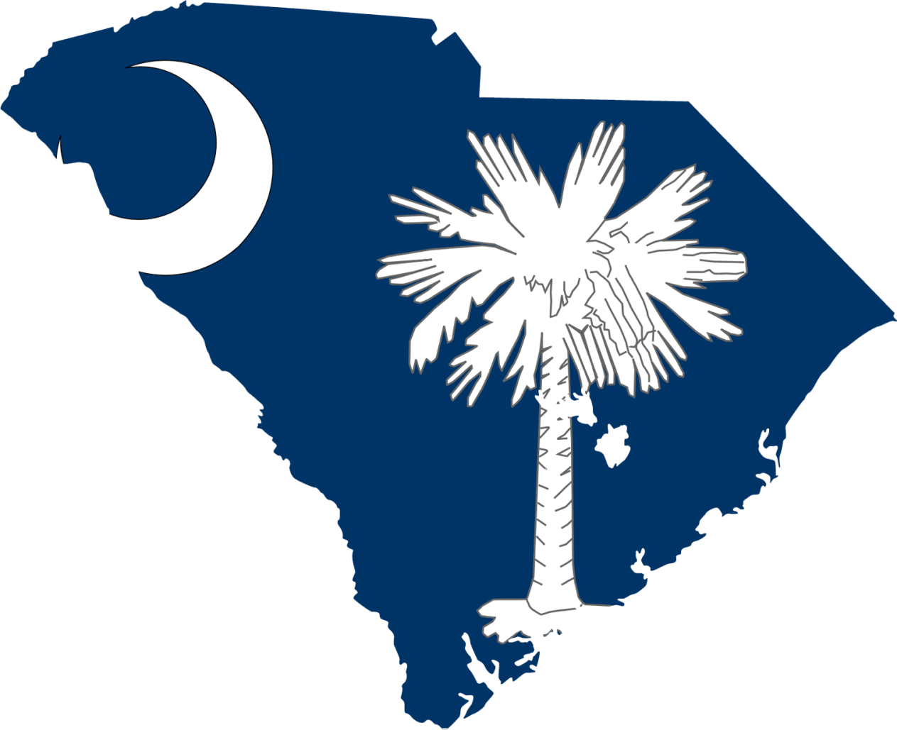
My Press Conference
South Carolina Flooding
By : Jason Reynolds

Slide 2
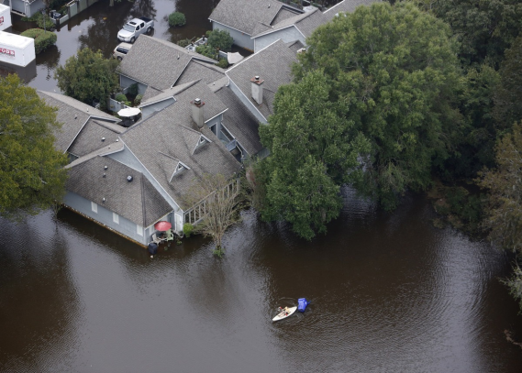
THE SOUTH CAROLINA FLOOD
Worst flood in modern history
October 2015
Worst areas
  North of Charleston & East of Colombia
Average accumulation 18-24 inches
Enough rainfall to fill the Rose Bowl 65,000 times

Slide 3
CAUSE OF FLOODING
3 Primary Causes
  Joaquin hurricane –hurricane that hit the Atlantic ocean and moved towards the bahamas; it was a level 4 hurricane at 155 mph;
  Non-tropical storm – a strong storm that came from the South
  Cold breezes from Canada – cold winds and pressure floated down to South Carolina

Slide 4
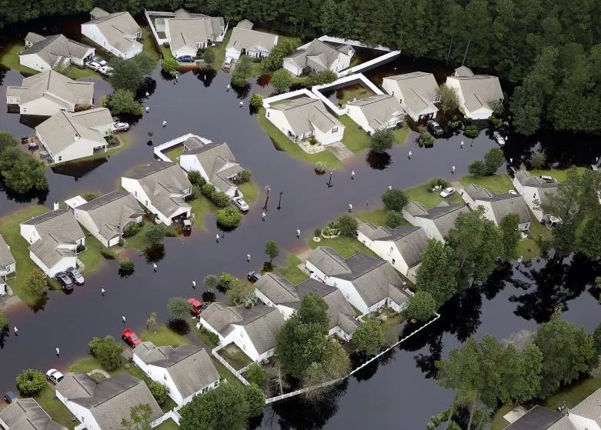
EFFECT OF FLOODING
550 roads closed or washed out
Schools canceled
The poverty rate went up
9 of 18 dams were breached or failed
2,000 vehicle collisions

Slide 5
FINACIAL IMPACT
160,000 approximately homes destroyed
800 people were temporarily housed in shelters
42,000 homes were without power
1,000 homes and businesses without power
Government spent 12 billion dollars on repairs

Slide 6
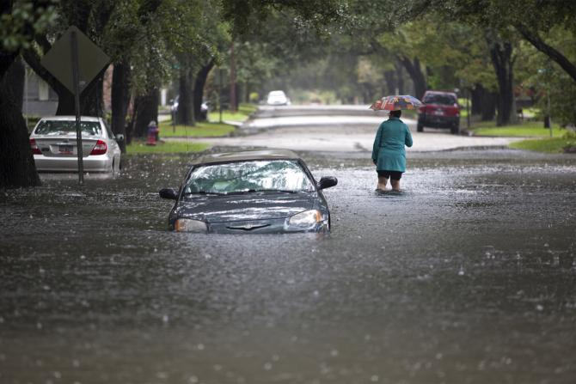
  PEOPLE
17 people killed
  6 traffic accidents
  11 drownings
  2 in North Carolina
“We still have to be cautious.”- Gov. Nikki Haley

